Slide 1
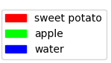
MFEIT for Stroke Triage Preliminary Data
Empty Water
Day2
Day2
Day 2: tested against day 1 data
Apple
Sweet Potato
Both
Day 1: train and test separate instances.
Day 1
Day1
Day1
Day2
CONFIDENTIAL
Mindseye Biomedical LLC

